Slide 1
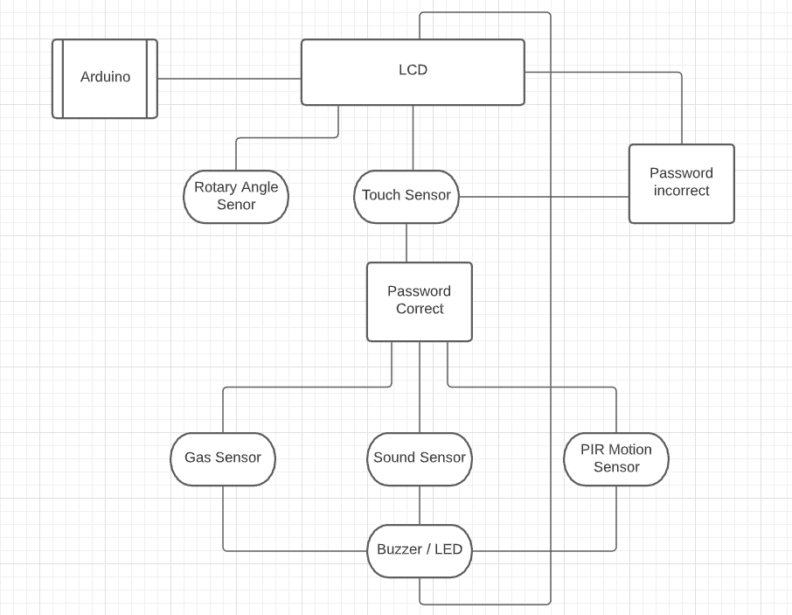
Burglar Alarm
Mohammad Ahmad
G00321094
SUMMARY
Burglar alarm is a smart security alarm. It detects burglars entering the building and it also detects gas in case of fire. A Person is detected by the PIR motion sensor and the Sound sensor. Gas is detected by a Gas sensor. When it detects either one of them, the LED turns on, buzzer goes on and it displays burglar on the lcd in case of a person detected or gas if gas detected.
For a person to be detected they have to be in range of the pir motion sensor to detect or they have to make a enough sound to be detected. For gas to be detected there has to be a amount of gas that could cause fire to be detected by the gas sensor.
Components
Arduino
Gas Sensor
PIR Motion Sensor
Touch Sensor
Rotary Angle Sensor
Buzzer
LED
LCD
Language
C++

